Slide 1
Project DataBase
SupermarketDB

Slide 2
Project Title: SupermarketDB Student Name: Nada Mostafa Course: DataBase Instructors: [En/Hussam Elnemr and En/Alaa] Date: 11May 2025

Slide 3
This project is based on a dataset collected from Kaggle.
The main goal is to design a relational database for a supermarket.
The database includes data on branches, customers, payments, products, invoices, and more.
It allows analyzing sales, customer types, and payment methods.

Slide 4
The database consists of 10 main tables.
Relationships were created using primary and foreign keys.
Key relationships:
Branches is linked to Cities
Invoices links Customers, Products, Payments, and Dates
Ratings is linked to Invoices

Slide 5
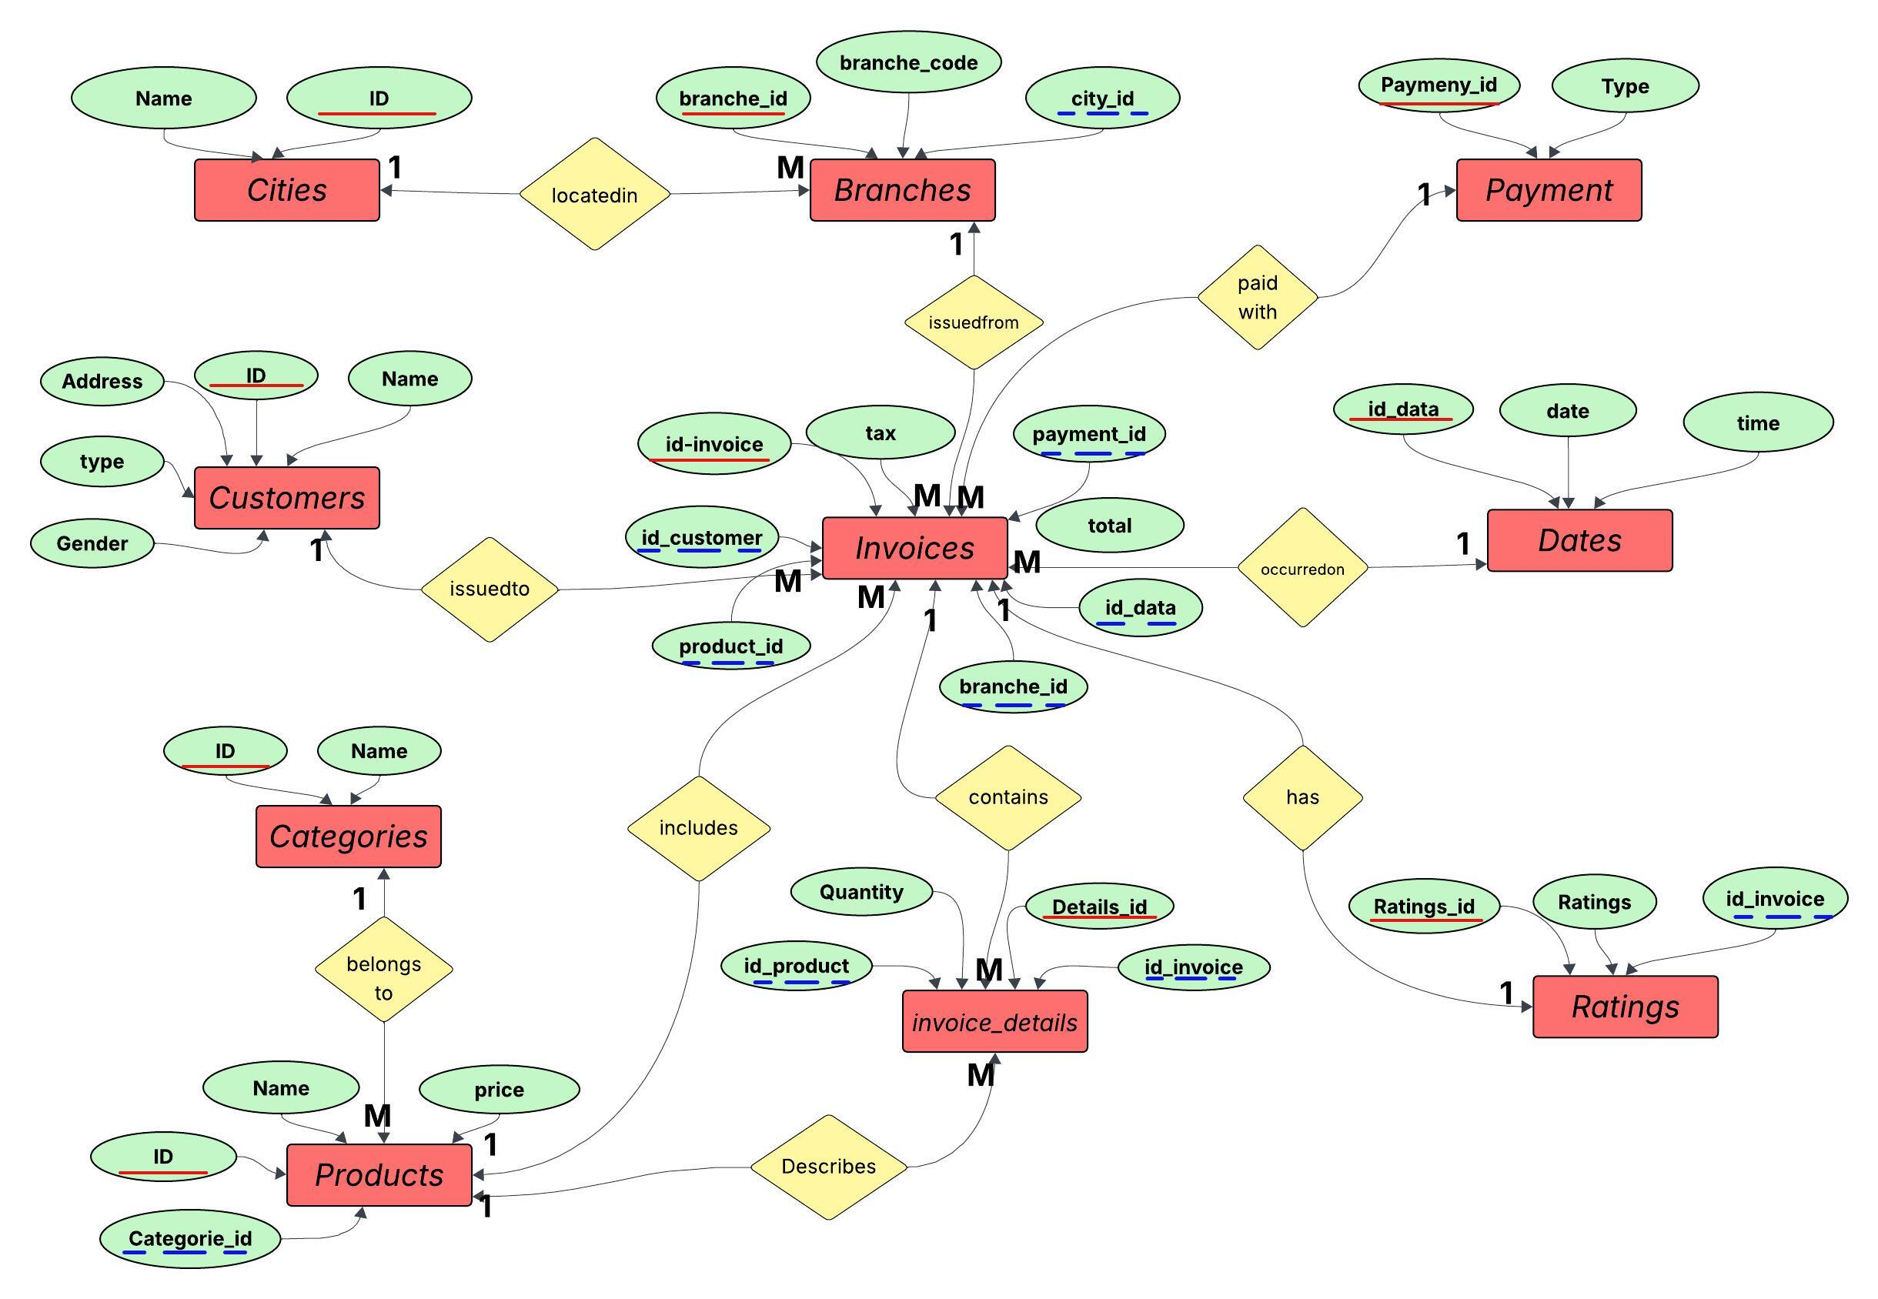
Erd:

Slide 6
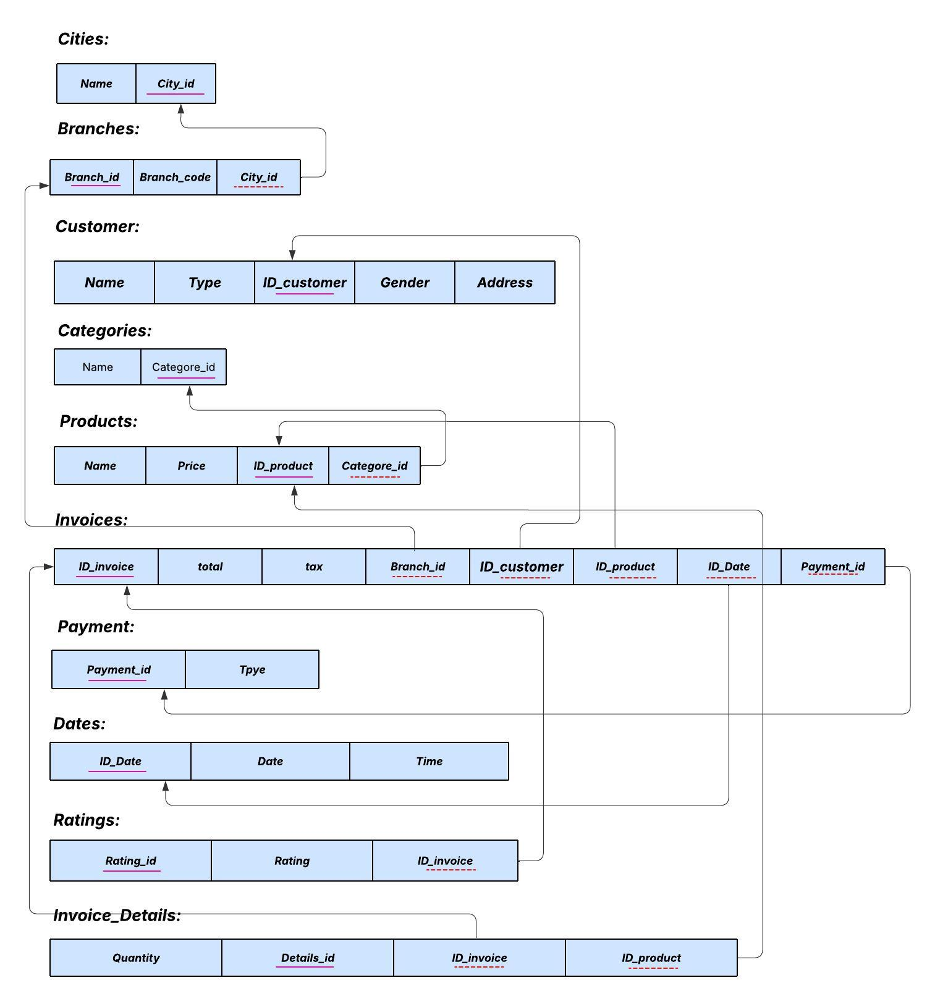
Scheme:

Slide 7
Sql:
CREATE DATABASE SupermarketDB;
USE SupermarketDB;
create table Cities (
CityID int identity(1,1) primary key,
CityName varchar(50) not null
);
create table Branches (
BranchID int identity(1,1) primary key,
BranchCode varchar(10),
CityID int,
FOREIGN KEY (CityID) REFERENCES Cities(CityID)
);

Slide 8
create table Customers (
name varchar(100),
CustomerID int identity(1,1) primary key,
CustomerType varchar(20),
Gender varchar(10),
address varchar(100)
);
create table Payments (
PaymentID int identity(1,1) primary key,
PaymentType varchar(20)
);
create table Dates (
DateID int identity(1,1) primary key,
DateValue date,
TimeValue time
);

Slide 9
create table Products (
ProductID int identity(1,1) primary key,
ProductLine varchar(100),
UnitPrice decimal(10,2)
);
create table Invoices (
InvoiceID varchar(20) primary key,
Tax decimal(10,2),
Total decimal(10,2),
Quantity int,
BranchID int,
CustomerID int,
ProductID int ,
DateID int ,
PaymentID int ,
FOREIGN KEY(BranchID) REFERENCES Branches(BranchID),
FOREIGN KEY (CustomerID)REFERENCES Customers(CustomerID),
FOREIGN KEY (ProductID)REFERENCES Products(ProductID),
FOREIGN KEY(DateID) REFERENCES Dates(DateID),
FOREIGN KEY(PaymentID) REFERENCES Payments(PaymentID)
);

Slide 10
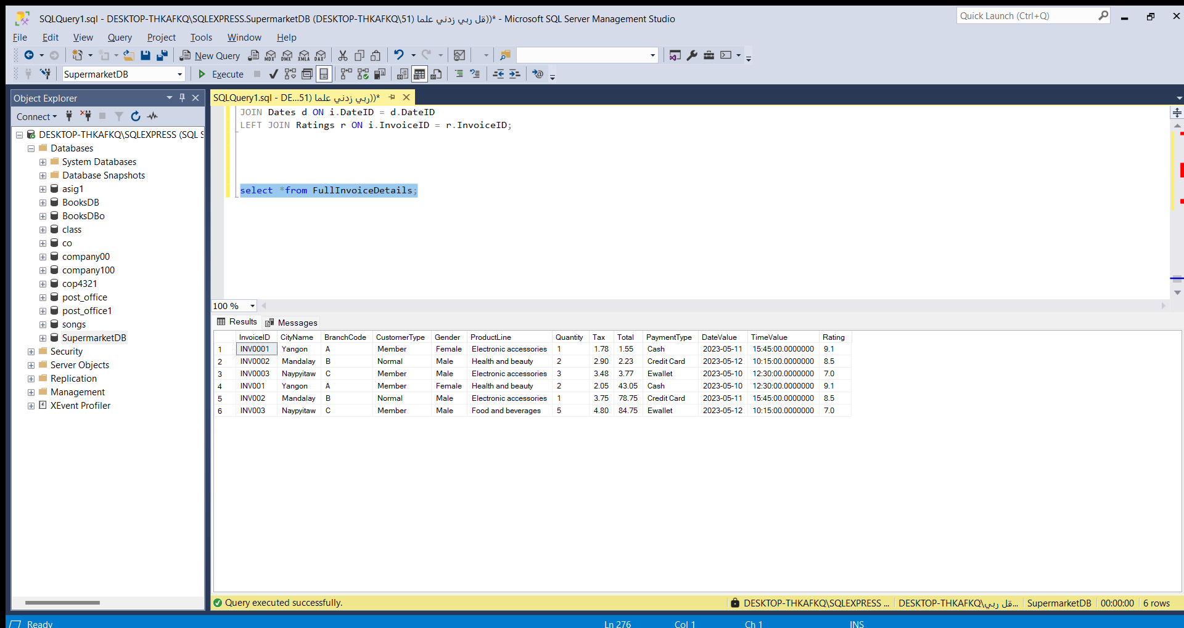
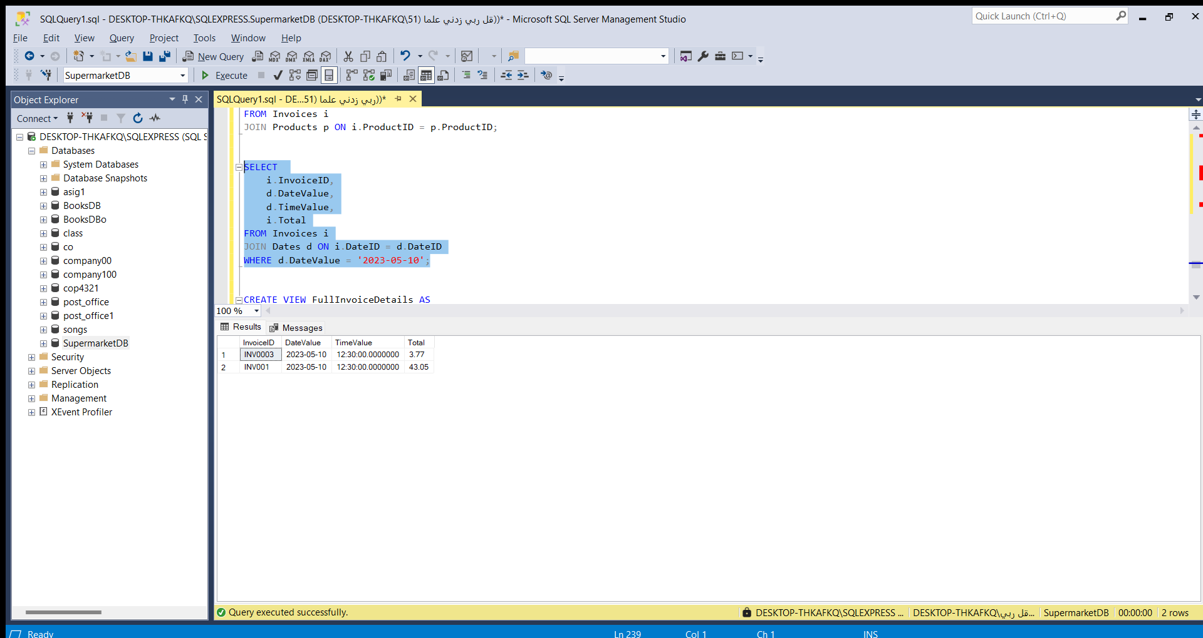
create table Ratings ( RatingID int identity(1,1) primary key, Rating decimal(3,1), InvoiceID varchar(20), FOREIGN KEY(InvoiceID ) REFERENCES Invoices(InvoiceID) );

Slide 11
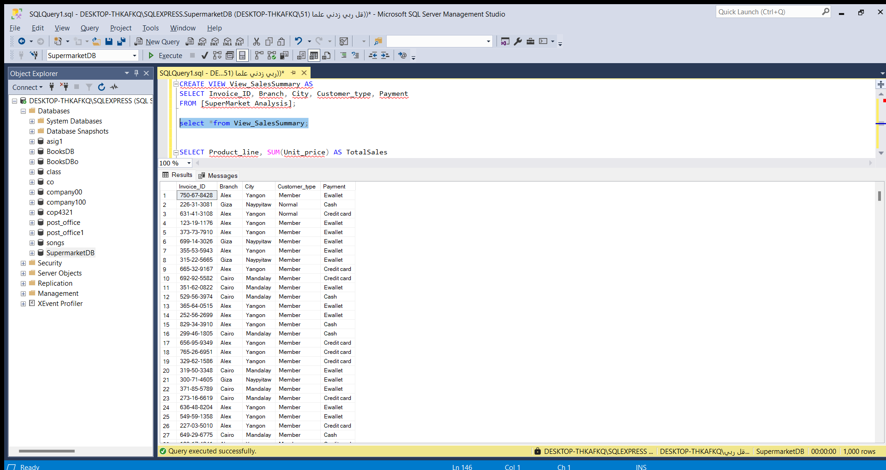
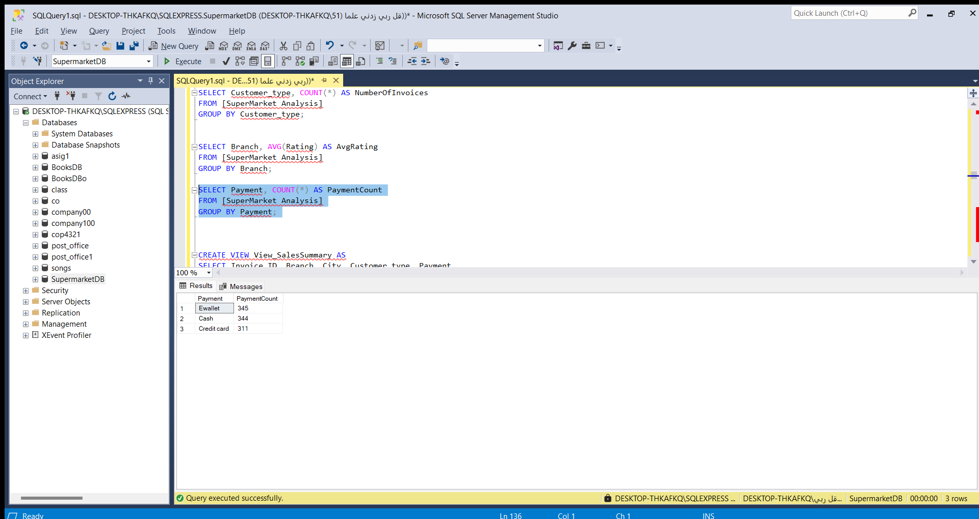

Slide 12
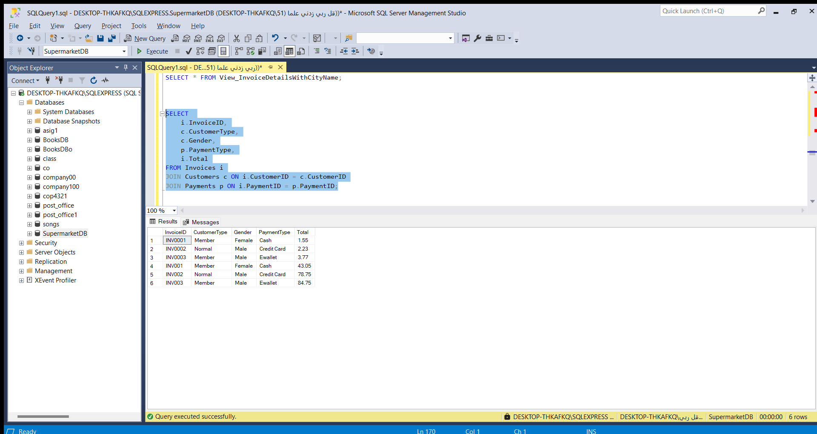
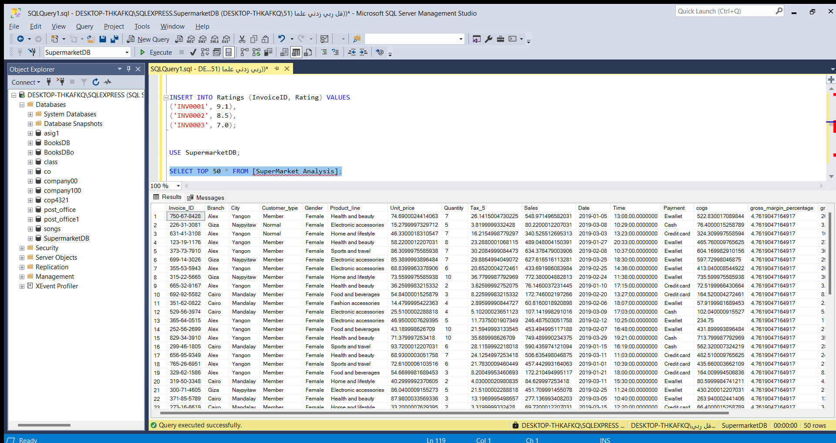

Slide 13
